Slide 1
Case Study
E-Commerce & Retail B2B
How Company focused only on vendors who tend to delay payment
Submitted by: Rajesh Thote, Rohit Ramachandran, Praveen Rathi
Batch: DS C52 23

Slide 2
The problem
Company
Context
Problem statement
Schuster is a multinational retail company dealing in sports goods and accessories with many vendors in B2B segment
In B2B segment it is business nature that many vendors payments are not as per payment terms and there are many cases of delayed payments
To get timely payment follow up with all vendors costs high and loss of time. Company wants to know in advance likely to delay in payment so that focus on those vendors would result timely clearance of invoices

Slide 3
Challenges
Domain knowledge is very important for EDA of the data, thus as of now this is a challenge how we can get some useful insights from the data which has real world relevance
To identify the trend of late payment for various customers, it will be challenging to segment customer so as to meaning full for the model
As this is a classification problem hence Model selection will be challenging as there are so many different models with pros and cons, we have to create a best model considering all limitations of a model

Slide 4
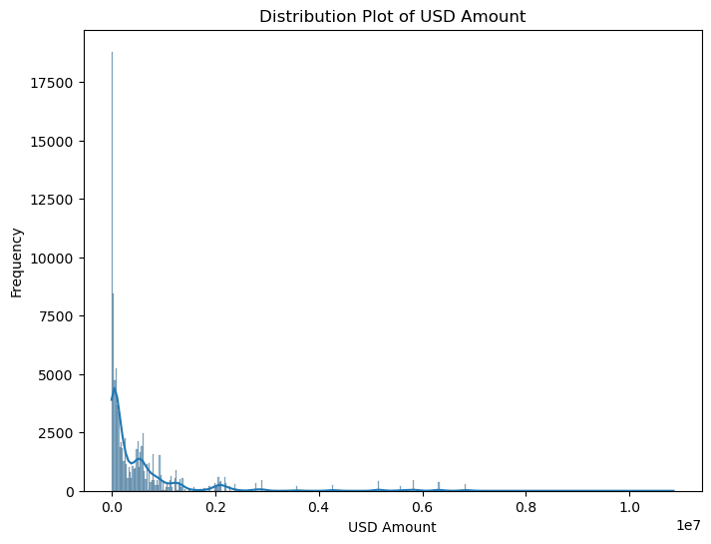
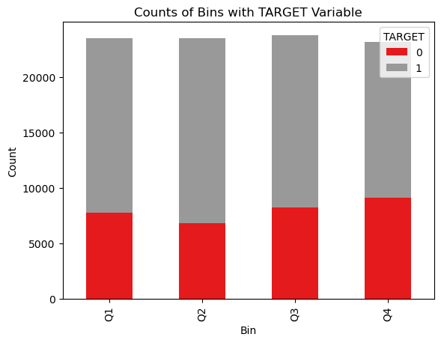
USD amount Analysis
We can see that major of the transaction are with value less than 1.5 million USD.
We can see that Q4 has slightly higher prone to late payment.

Slide 5
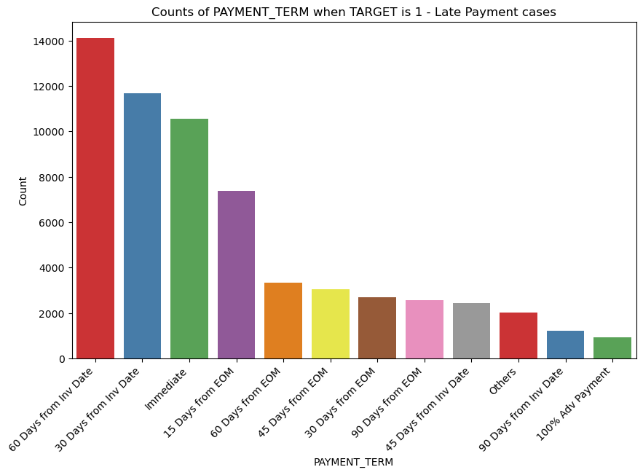
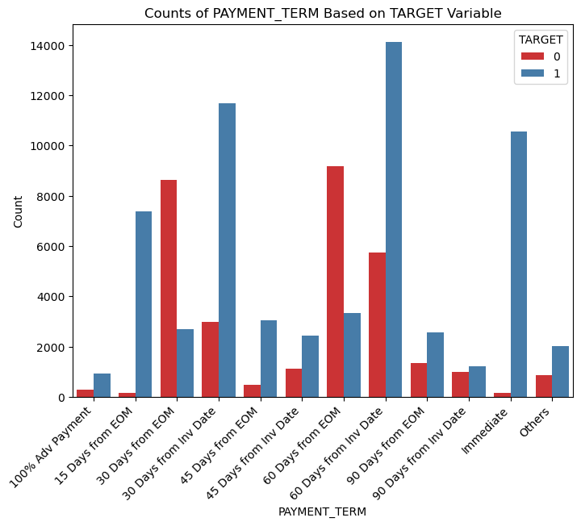
Set Priority
We can see from below bar plot, 60 days, 30 days and immediate payment terms are with most delays and can be targeted.

Slide 6
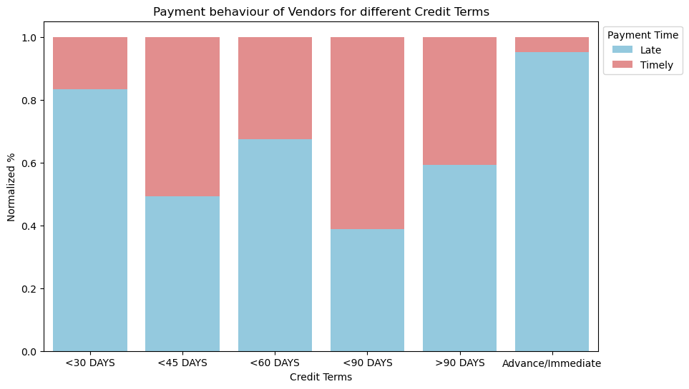
Payment Terms Analysis
Challenge 1
As we see vendors with payment terms immediate/advance and 30 days are more prone to late payment, this may be when immediate payments are actually made after goods receipt

Slide 7
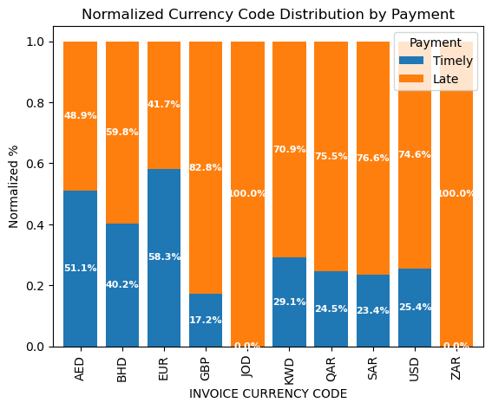
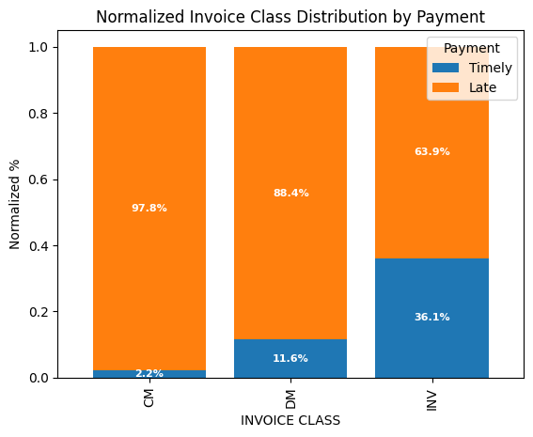
Finding Good and Bad pay master type
Customer paying into EUR are with good track record of payment against all other.
Customer whose payment method is CM are risky with high rate of delayed payment.

Slide 8
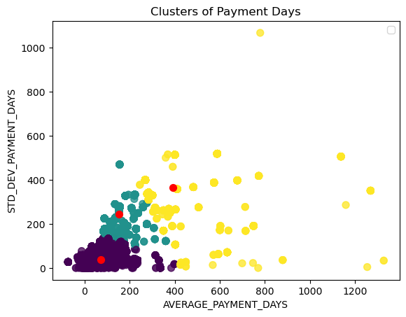
Clusters of Customer on Basis of Payment Days
Challenge 1
We found with Elbow curve method/SSD and Silhouette analysis, 3 are the best way to form a cluster.
We segmented customers based on their average payment days and standard deviation of payment days.
Among these we can see as average payment days are higher the segment is less clustered.
This shows that lesser the paymet days less is the deviation.

Slide 9
Model Evaluation- Logistic Regression
Summary of model
Train Test
# Accuracy 70% 74%
# Sensitivity 70% 80%
# Specificity 70% 62%
# Precision 82% 81%
# Recall 70% 80%
Our model is trained with ~70% accuracy has resulted on test data with ~74% accuracy

Slide 10
Logistic Regression

Slide 11
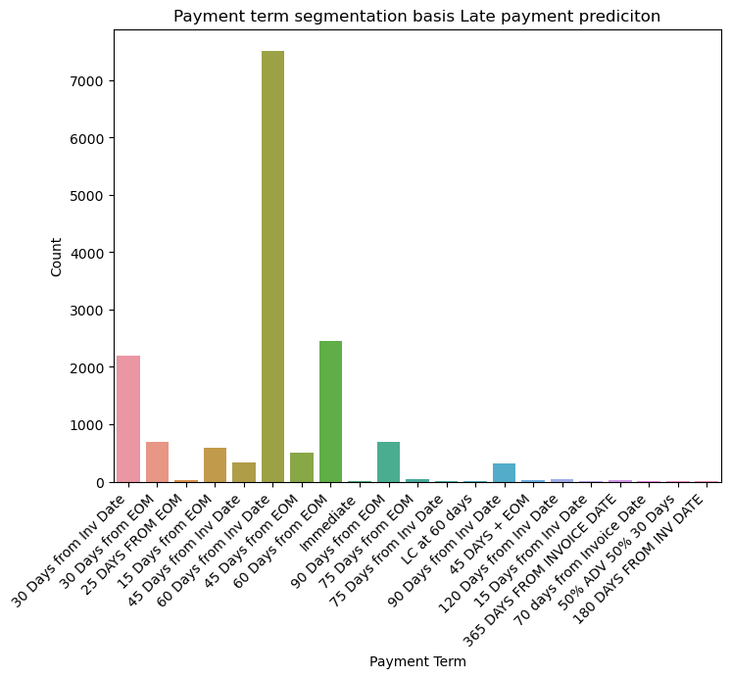
Late Payment Prediction (on Payment term)
Challenge 1
Company should focus on invoices with payment term ‘60 & 30 Days from inv Date’ as these have higher late payment chance

Slide 12
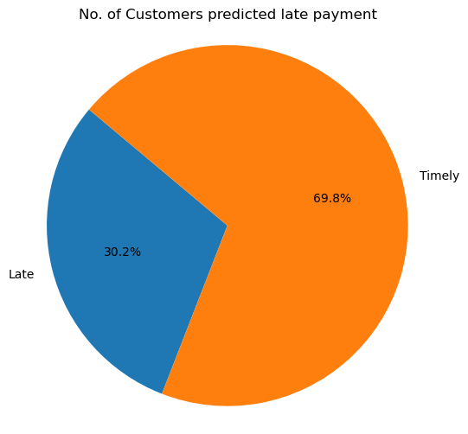
Final outcome of Model
Challenge 1
Our model has identified 30.2% customers as potential for late payment, accordingly company can focus on these customers for improving timely payment realisation

Slide 13
Suggestions
Challenge 1
Company may chase invoices with immediate payment basis as these are observed to be late majorly

Slide 14
Thank you

